Slide 1

Microsoft Tools for AI Object Detection
Jorge Costa

Slide 2



Agenda
Technologies Introduction
Use Cases
Processes and Parametrization
Results of Experimentation
Conclusions

Slide 3
Technologies Introduction
 | AI Builder | Custom Vision | Azure ML Workspace
Programmable | - | x | x
User Friendly | x | - | -
Precise | - | ? | x
AI Builder is limited to Microsoft Power Apps ans Flows
Custom vision can be used as a call API.

Slide 4
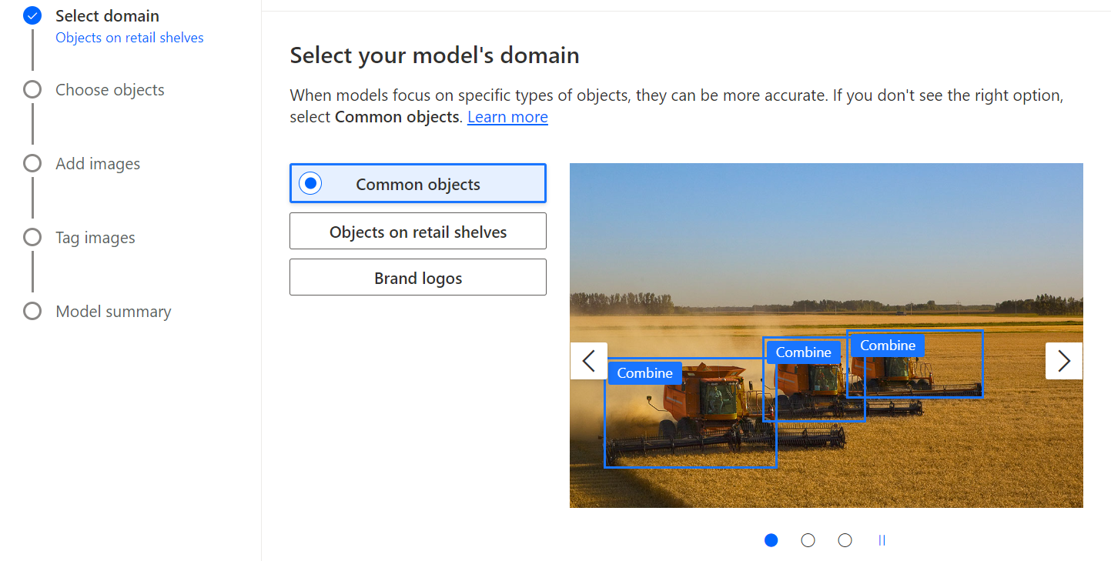
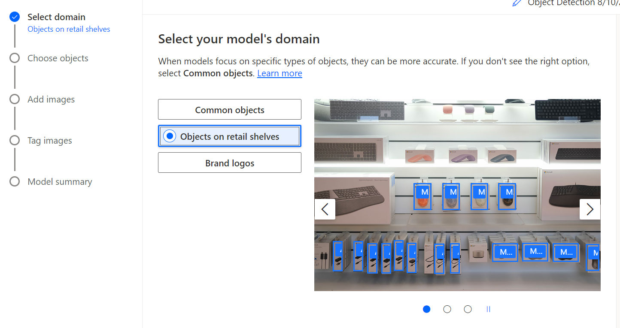
AI Builder
AI Builder is a straightforward tool.
After selecting the Object Detection Model, there are three options, the one that was used was the Common objects.
There is also an option for Objects on retail shelves, for future investigation and testing in different use cases.

Slide 5
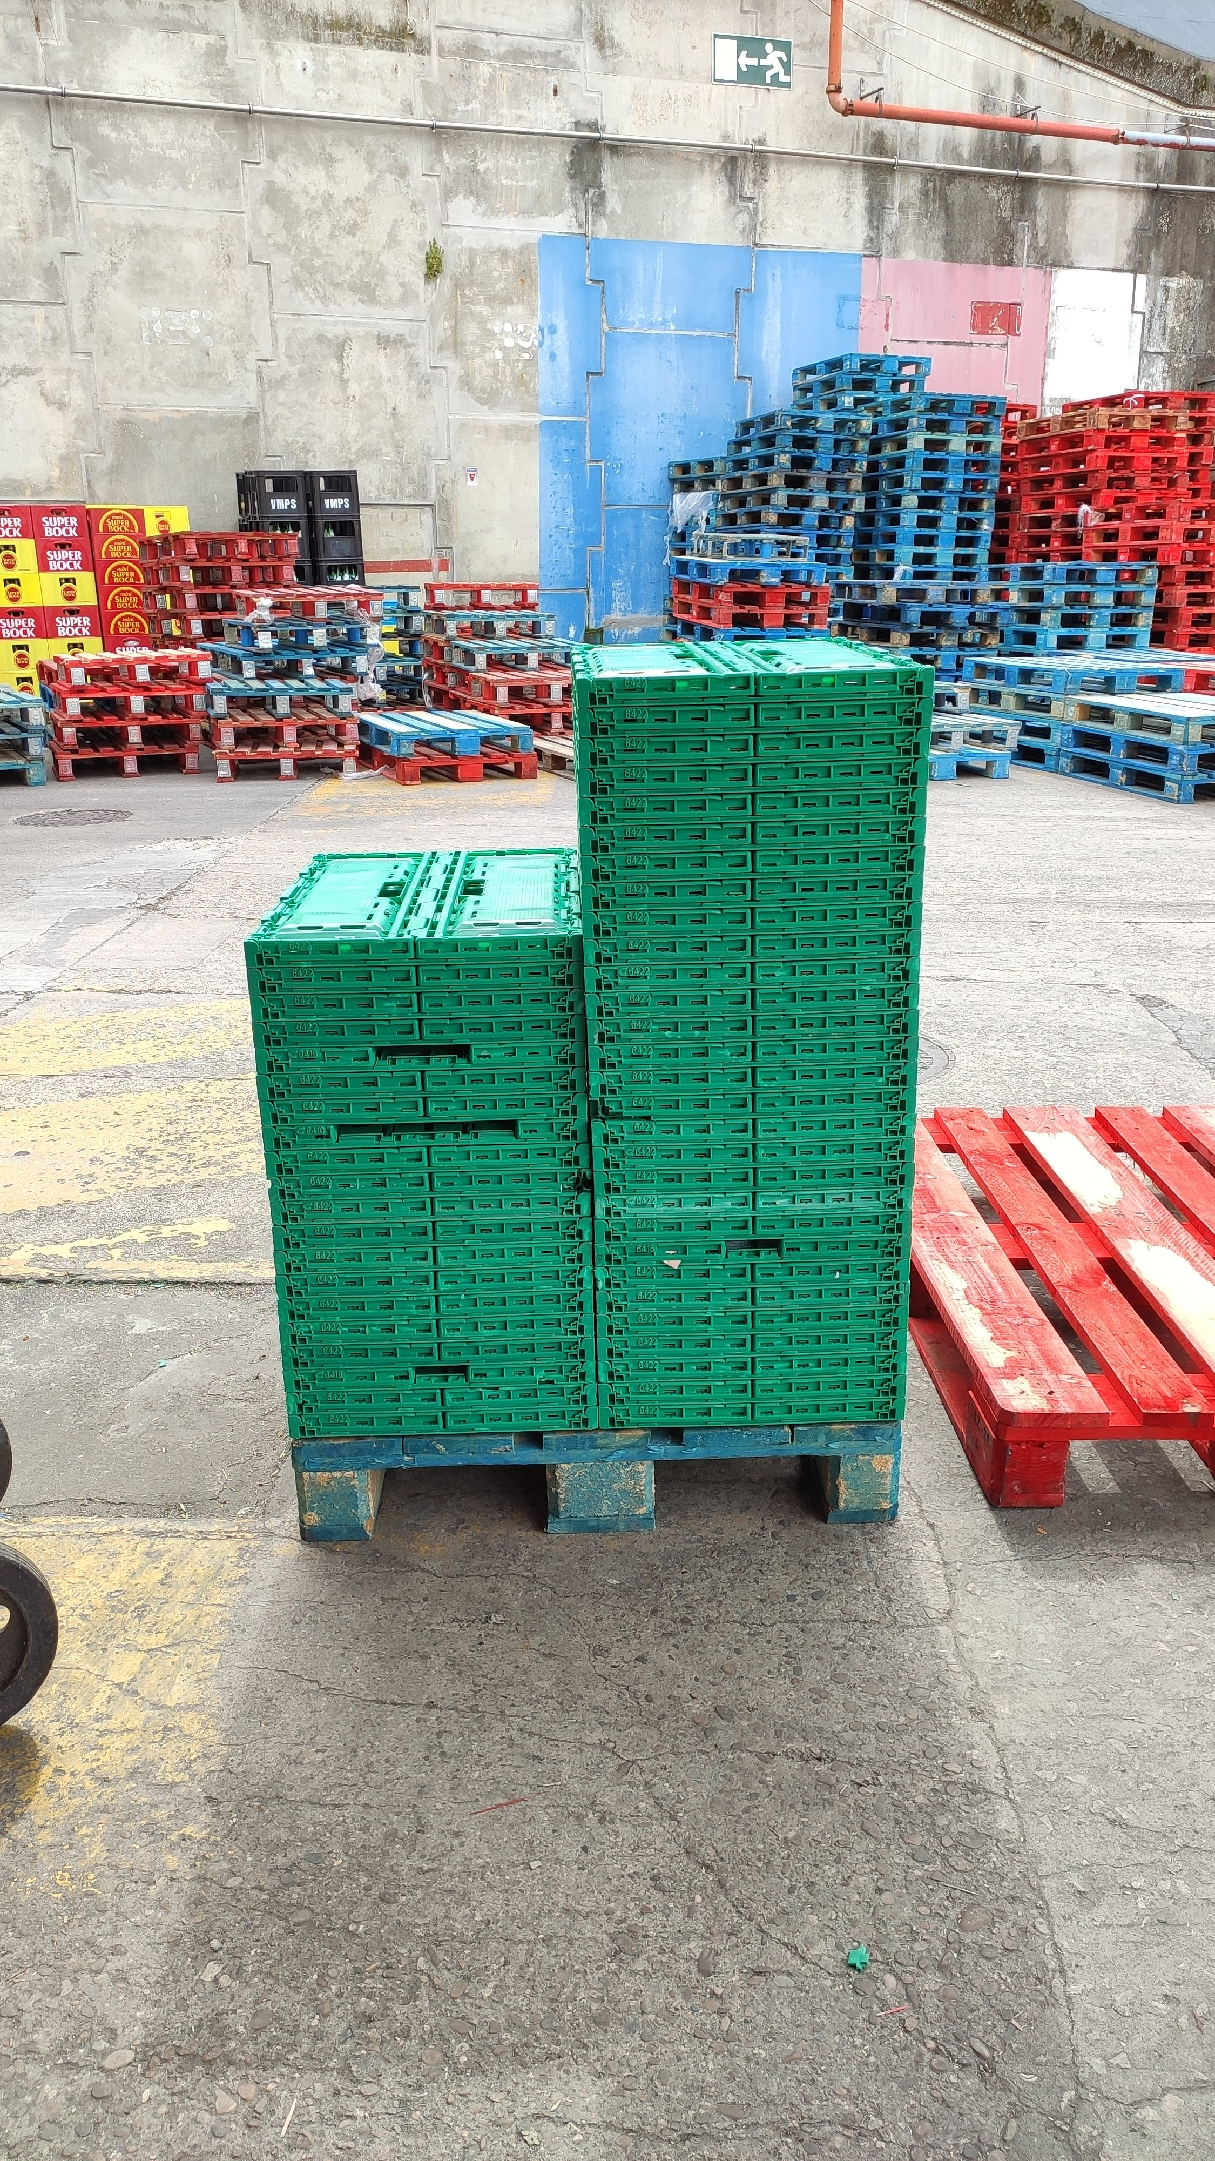
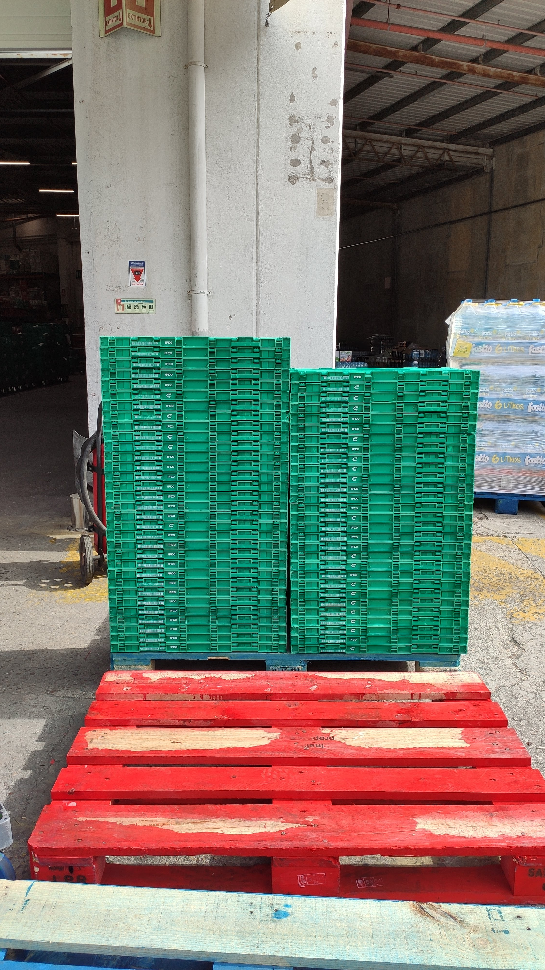
Use Cases
The selected Use Case for this experience was the counting of expedition boxes of e-commerce in store.
There was given already a small set of photos, in a narrow and wider perspective. There was three types of boxes and the most common was choosen for tests.
Also for training porposes the photos vary in terms of lighting, distance, volume and resolution.
For the following experiences, there was used the photos with wider perspective.
Narrow
Wider

Slide 6
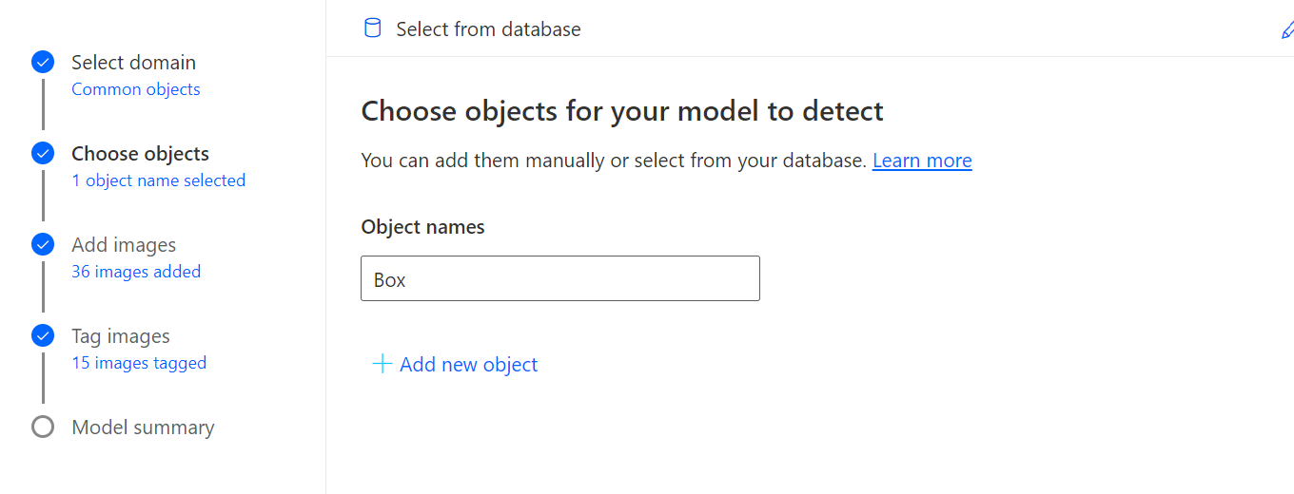
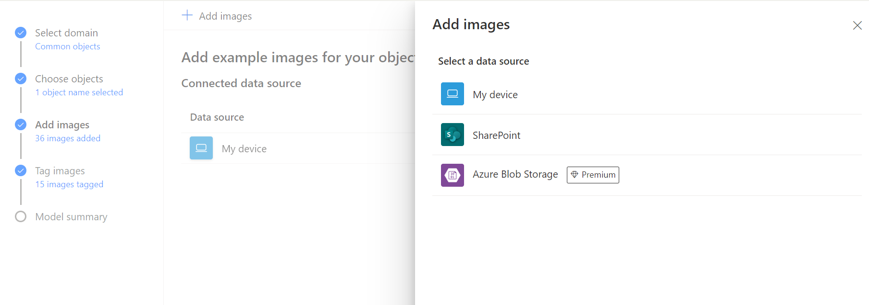
Process and Parameterization
The Images need to have the following characteristics:
Format: JPG, PNG, BMP.
Size: maximum 6MB, minimum width / height 256 x 256 pixels.
Have at least 15 images per object for the training set.
Images with diferente lighting, sizes and capture diferent parts of the object.
The object tag for detection was named “Box”.

Slide 7
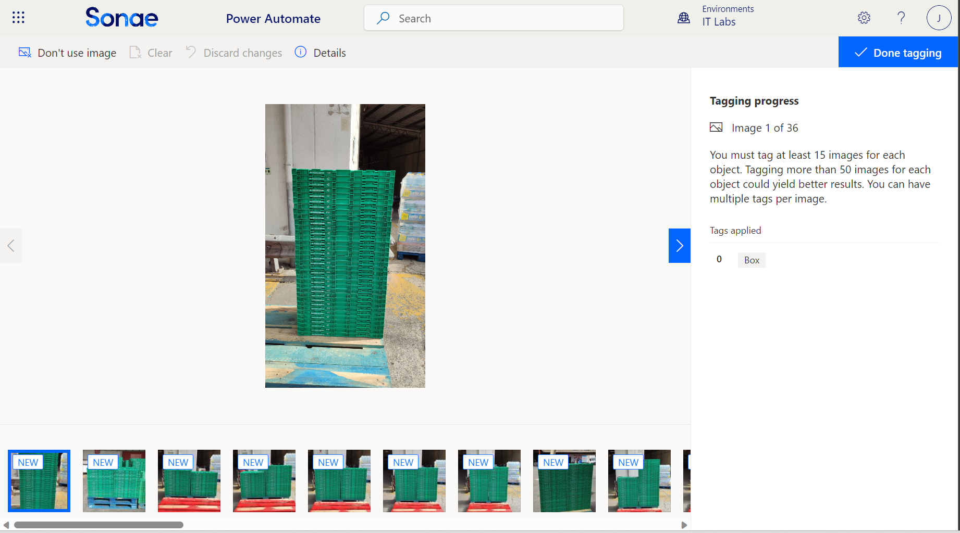
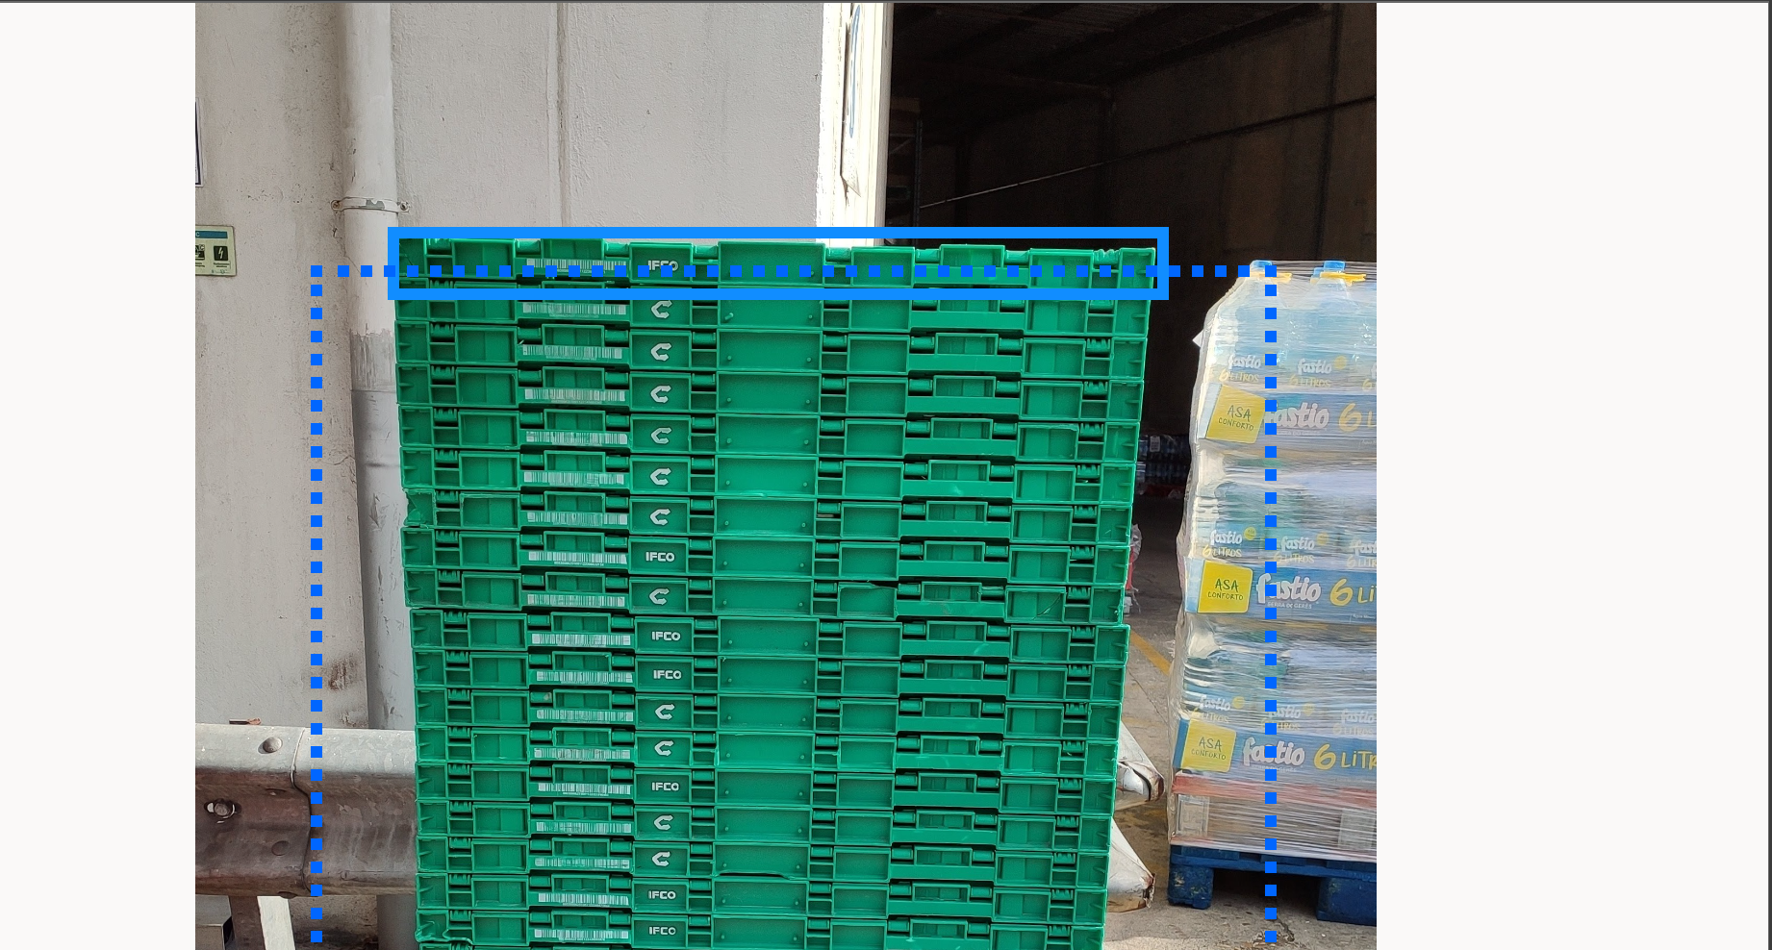
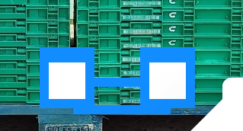
Process and Parameterization
After uploading the images, there is a tagging process to train the model identify the boxes.
The tagging process occurs in the browser and is up to the developer to indentify the boxes manually.
Since individual boxes were too small, the difficulty of the task increases and it is needed to zoom the browser for a better selection.
The selector tool had a minimum height and some images have boxes smaller than that height.

Slide 8
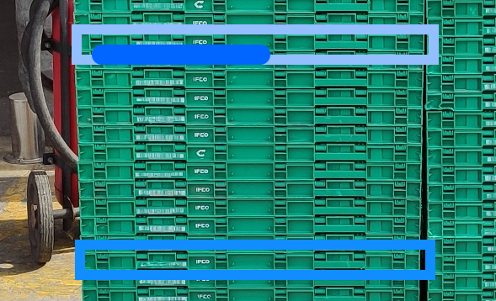
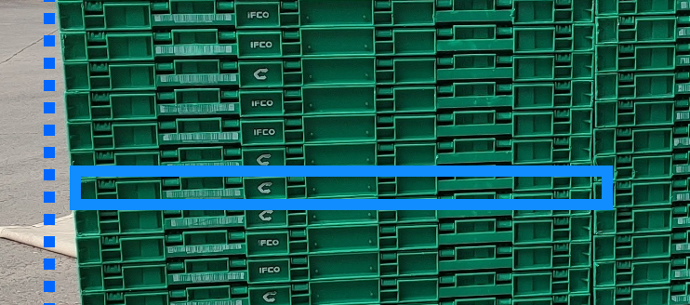
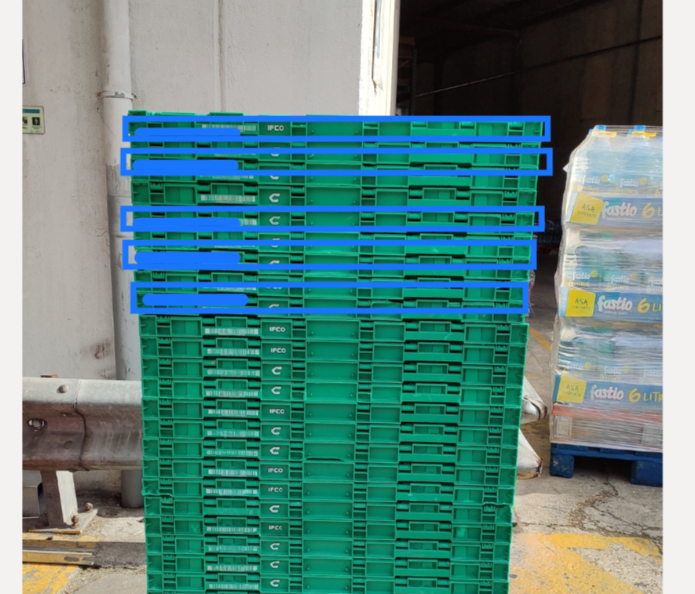
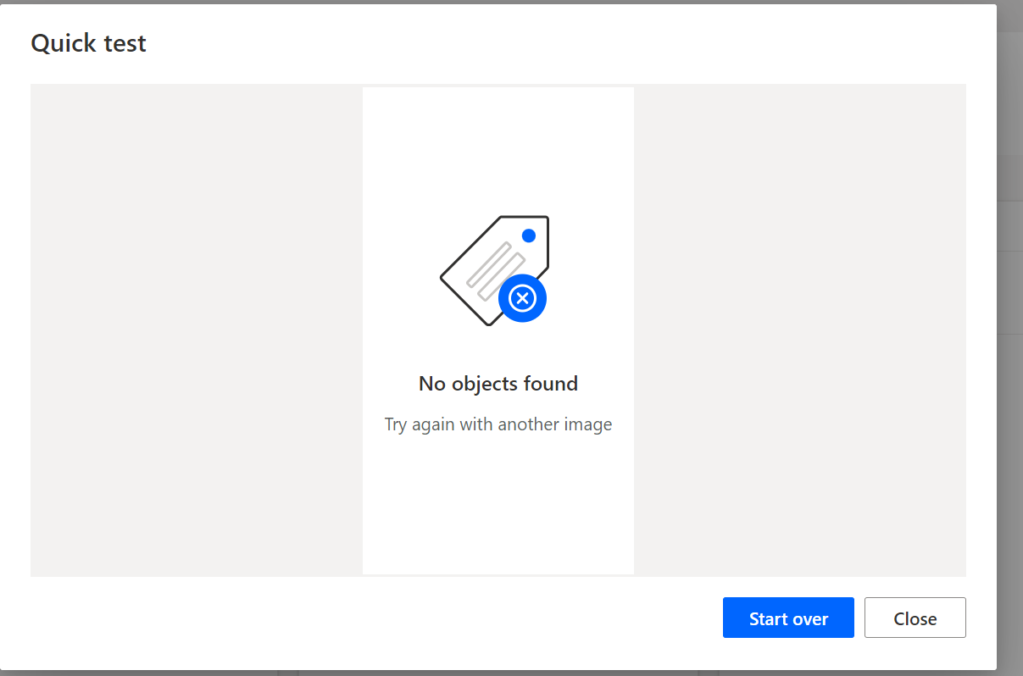
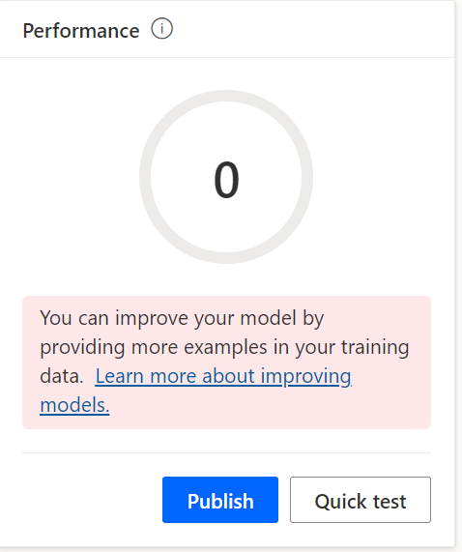
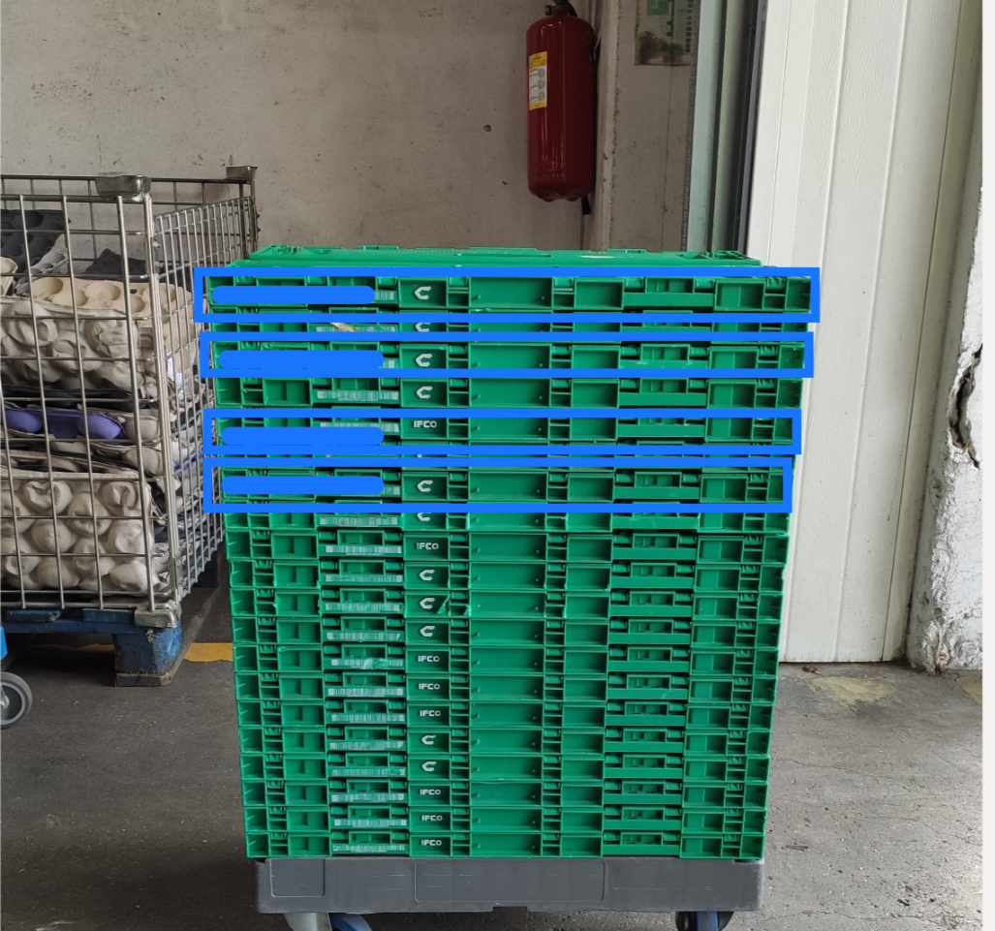
1. Box Detection Total Box
As mentioned before, the tagging process was difficult, and due to the angle and height of some boxes it was impossible to make a good selection.
The Perfomance Result of the model was 0.
It could detect some boxes in some images, but couldn’t detect none in others.

Slide 9
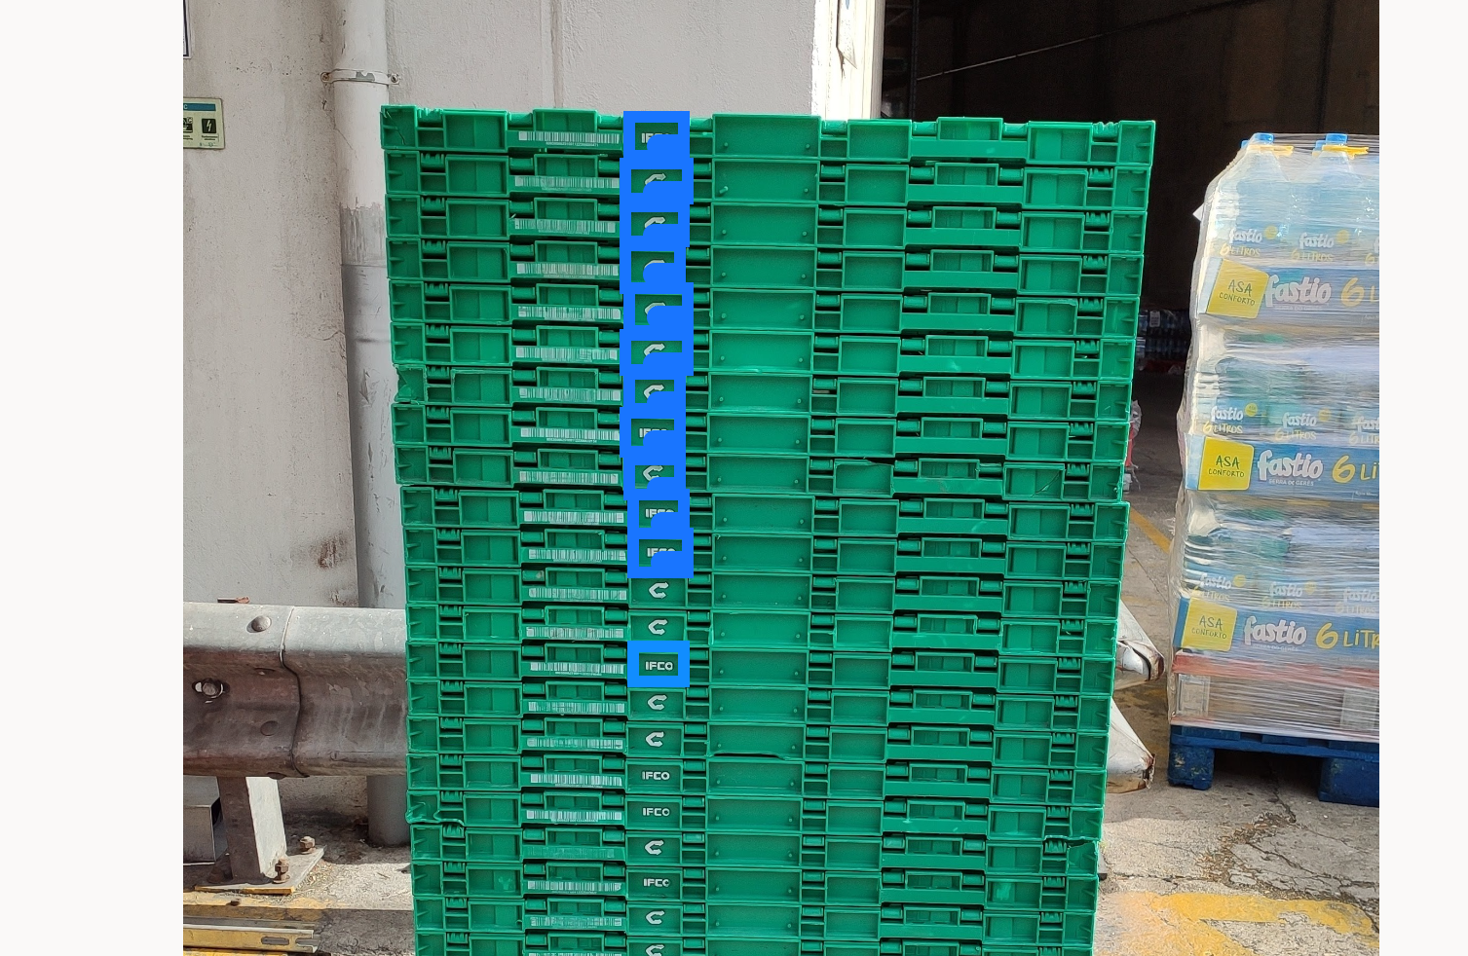
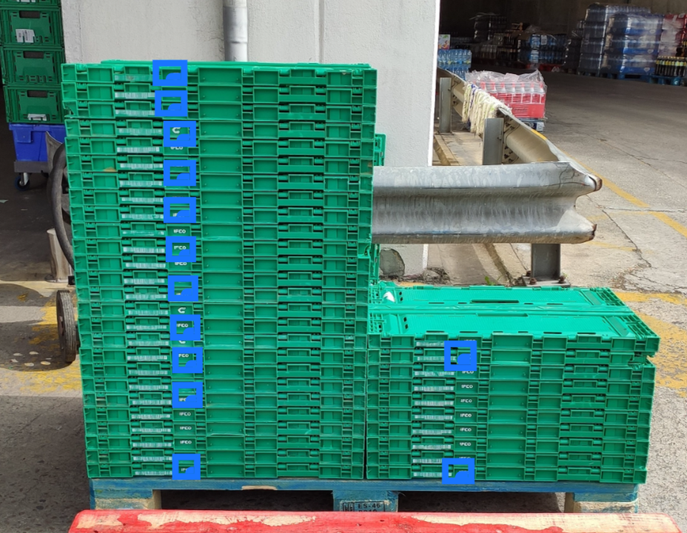
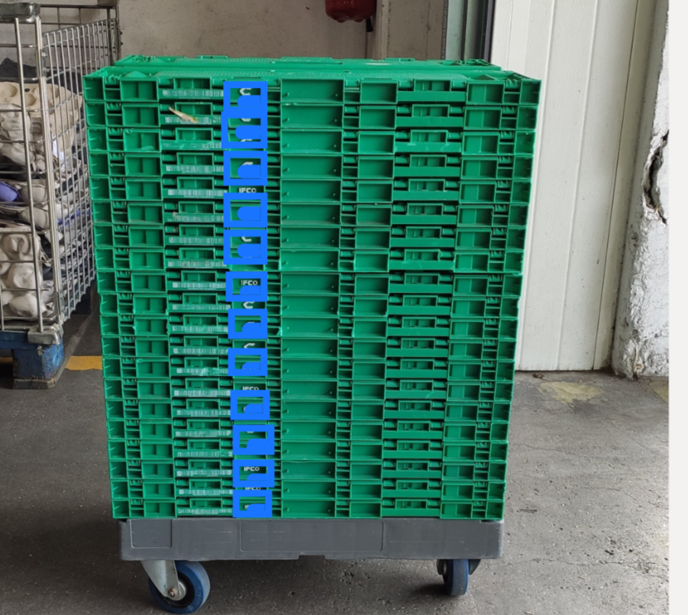
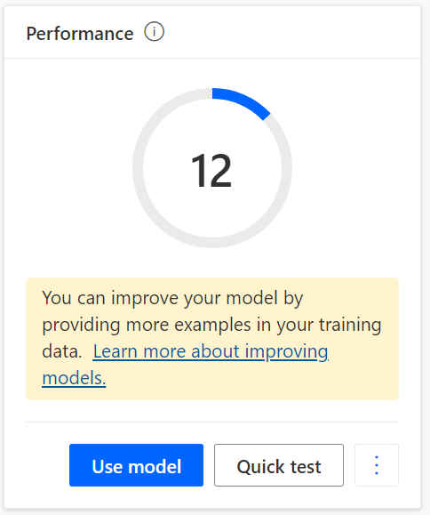
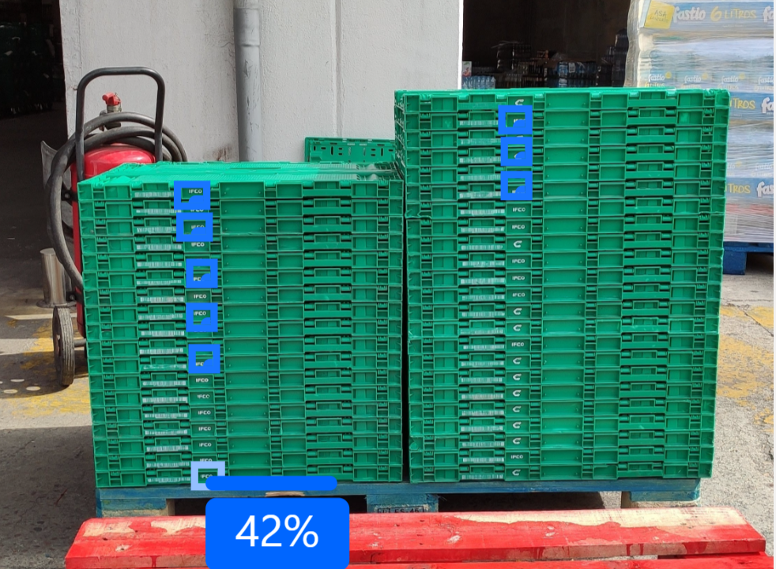
2. Box Detection Letter Symbol
2. Box Detection Letter Symbol
Using a small fraction of the box with a Symbol could help the AI model since it was more distinguishable.
Using a small fraction of the box with a Symbol could help the AI model since it was more distinguishable.
The Perfomance Result of the model was 12.
It detected a higher number of boxes, and consecutive ones.

Slide 10
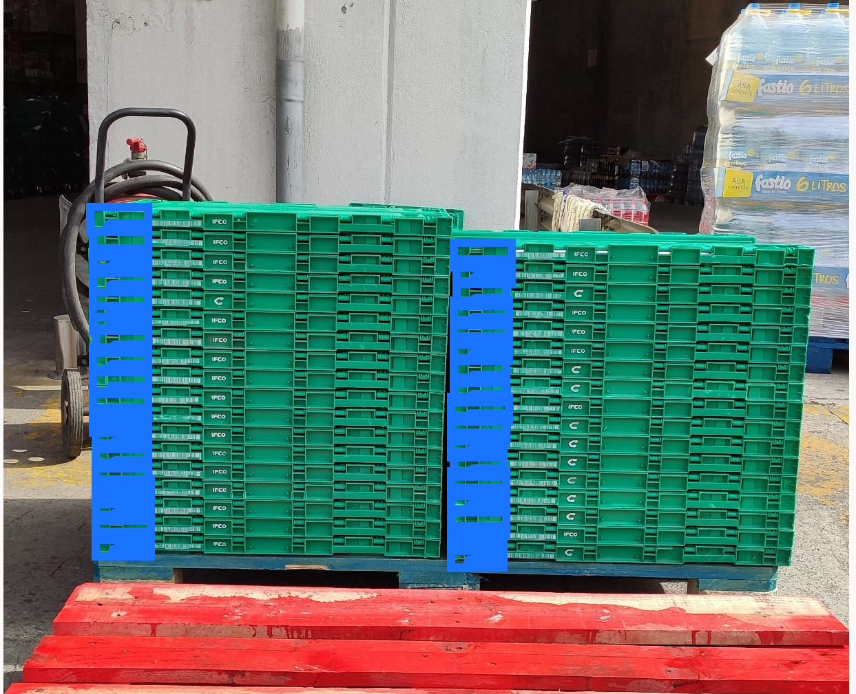
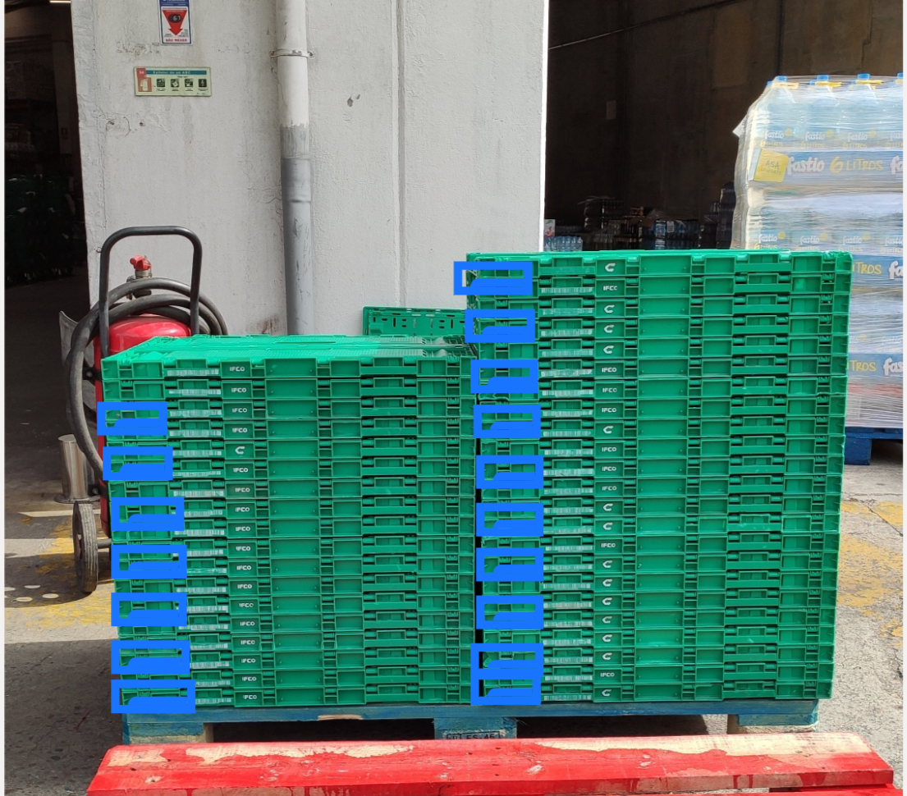
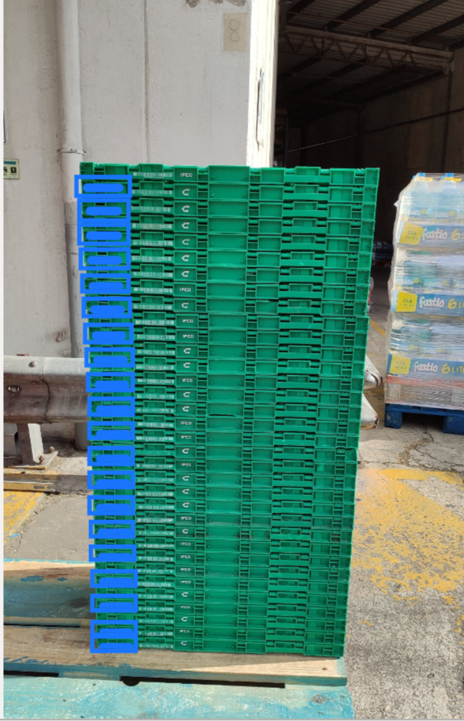
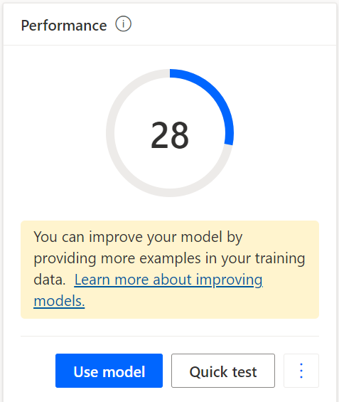
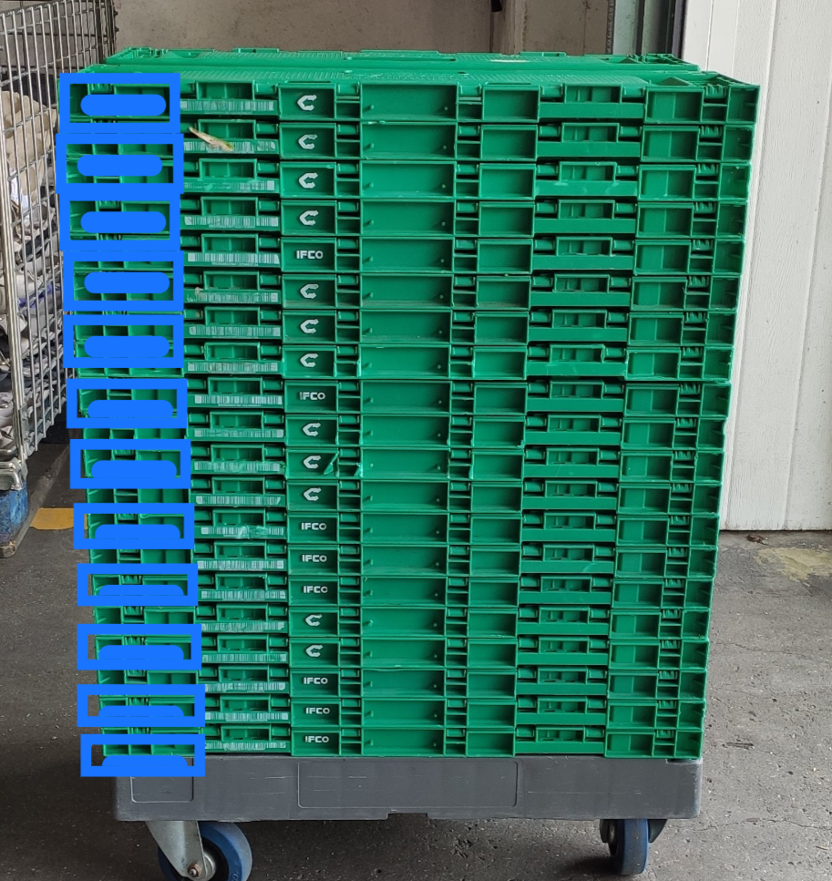
3. Box Detection Left Corner
Experiment with a different part of the box, having a small patern and border of box.
The Perfomance Result of the model was 28.
In this model there was selected a very high number of tags.
Could detect more boxes in the bottom of the stack, but there was a lot overlapping detections

Slide 11
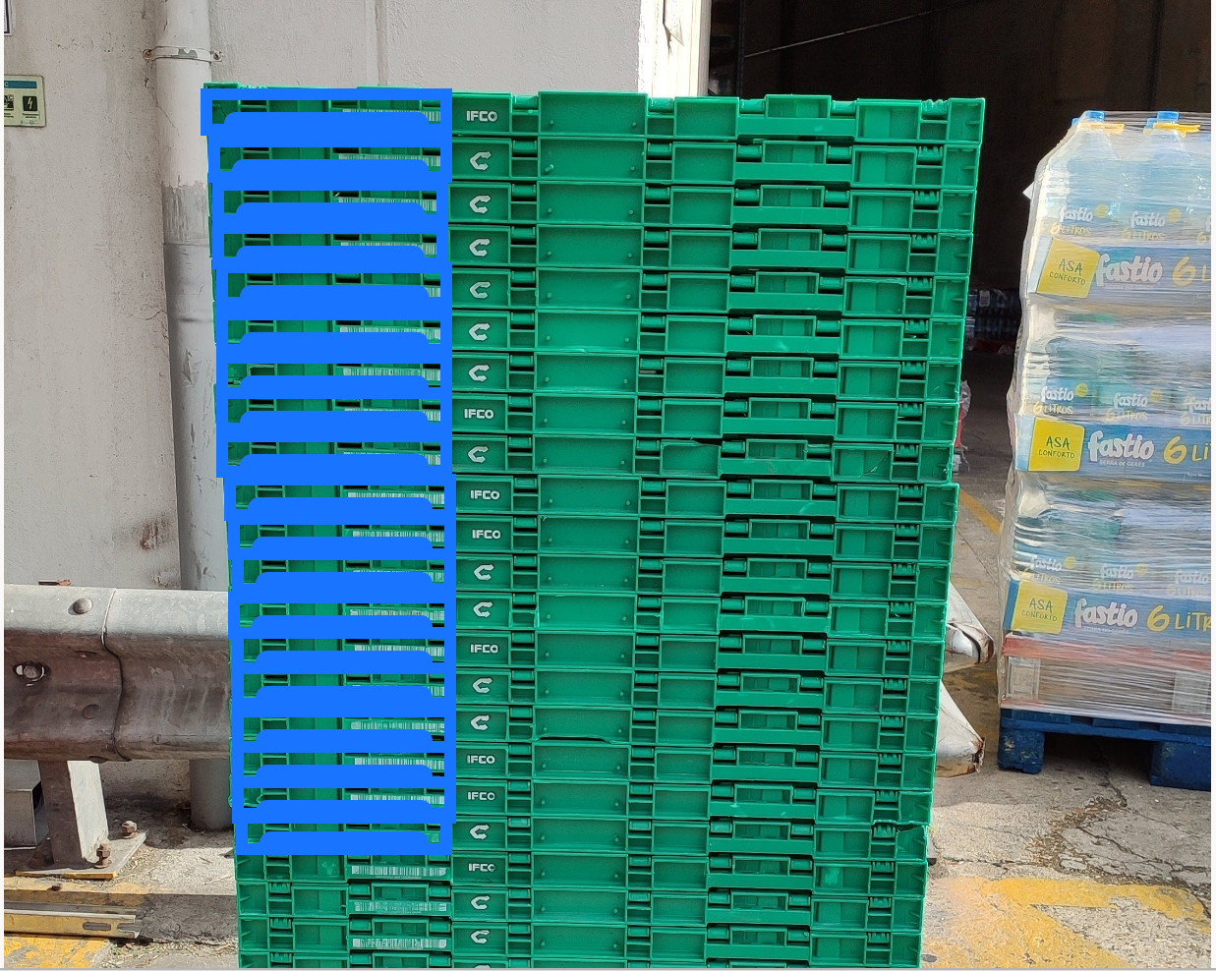
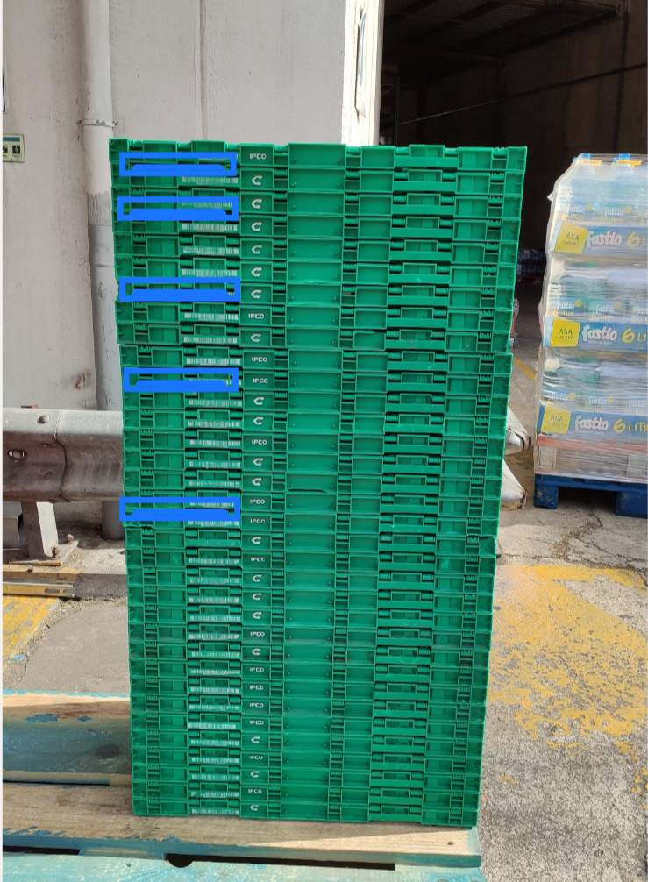
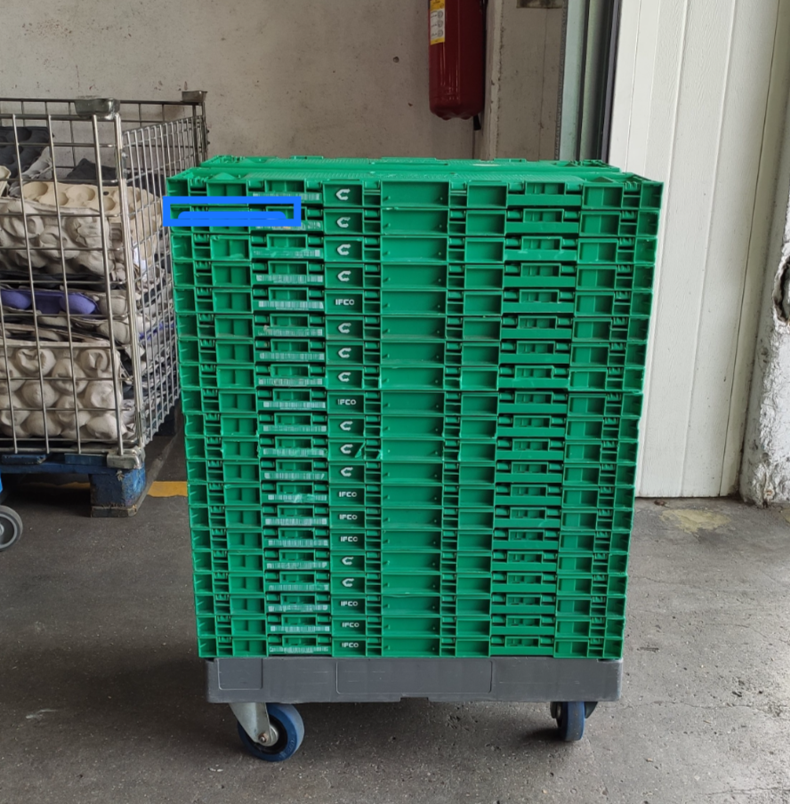
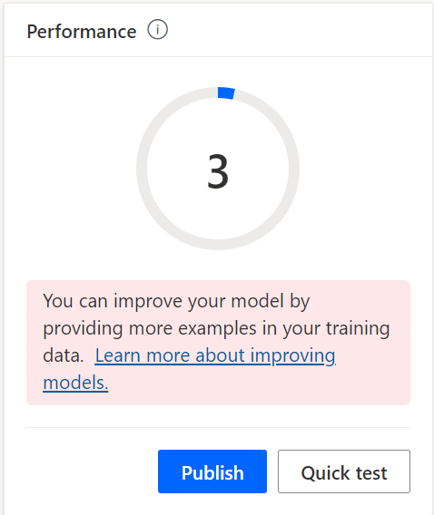
4. Box Detection Left Corner with Barcode
The idea was to identify the corner pattern toghether with the Barcode of the box the get a higher specificity.
The Perfomance Result of the model was surprisingly low.
It was one of the models with less detections.

Slide 12
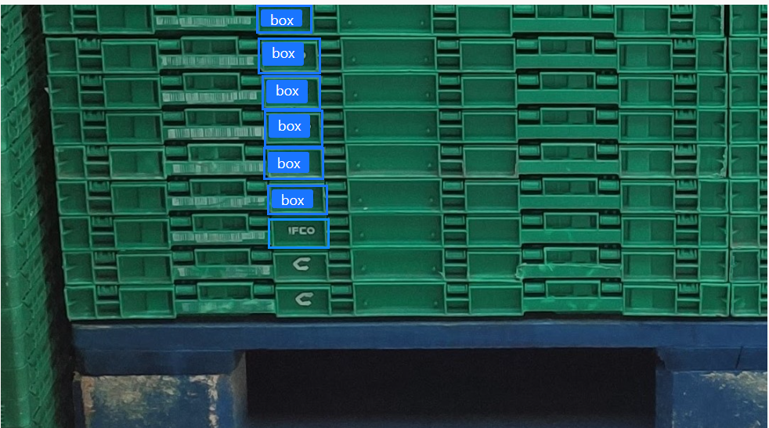
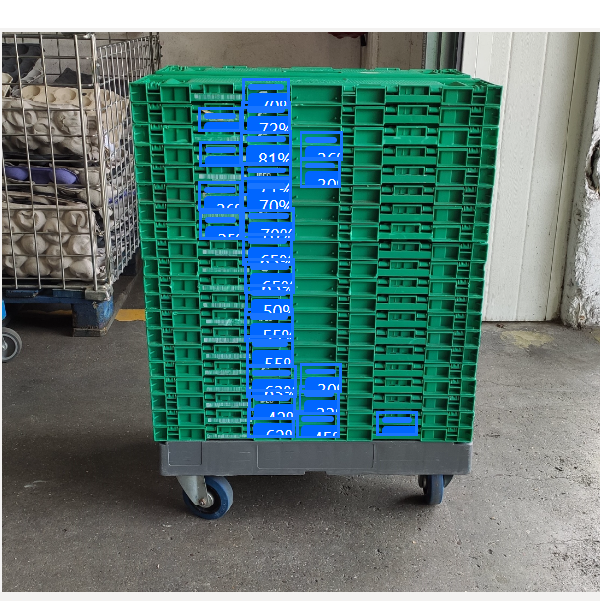
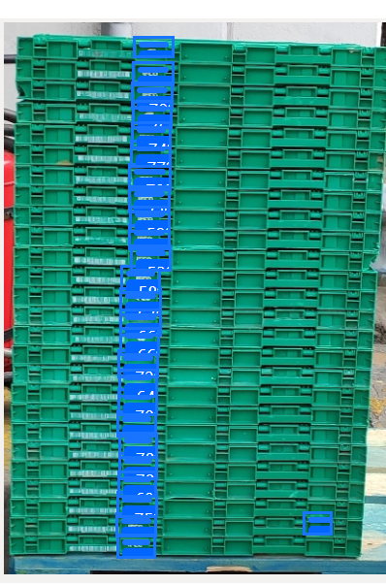
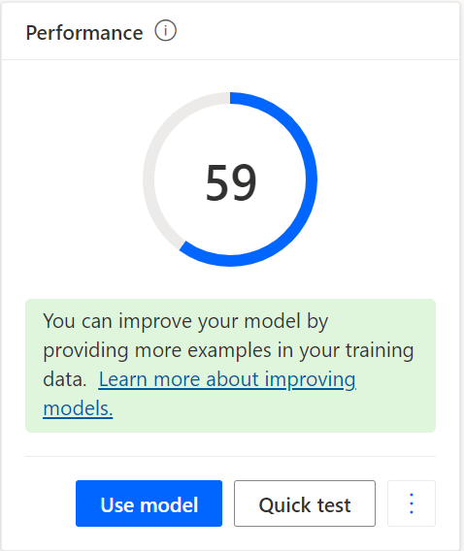
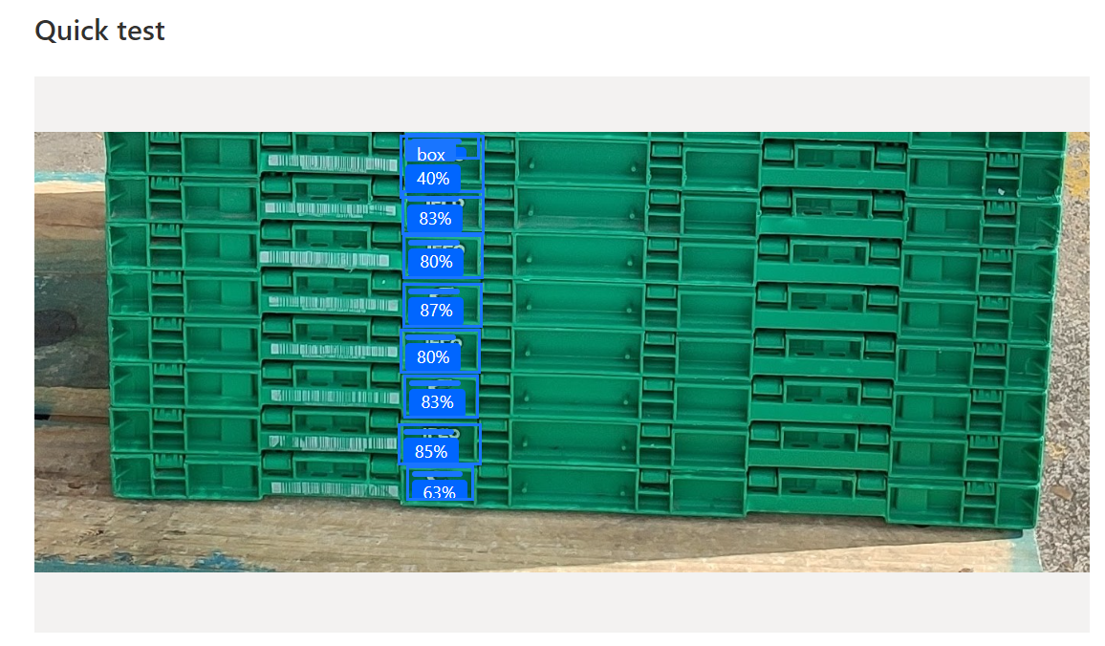
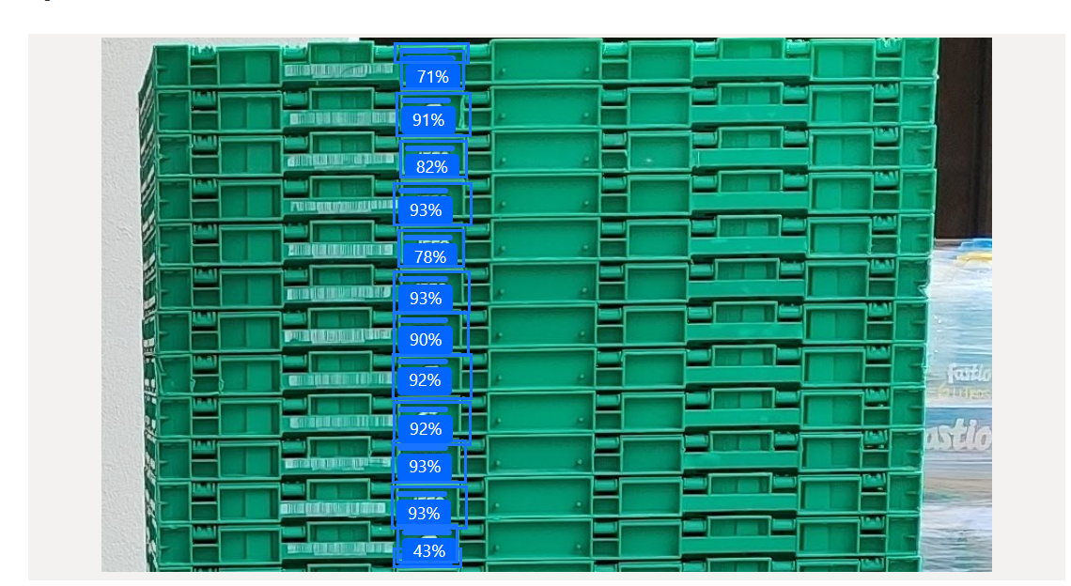
5. Box Detection with Image Parts Symbol Letter
In this model, the images were cropped so that the boxes could be bigger and the model could have a better detection. It was tested with the Symbol part.
The Perfomance Result was the best so far.
The procedure is unrealistic since the use case gives images of total size, but it can be used for future ideas like using two models (one for stack detection and other for box counting), or even a model that can divide the image.
It was the model with better % of detections.

Slide 13
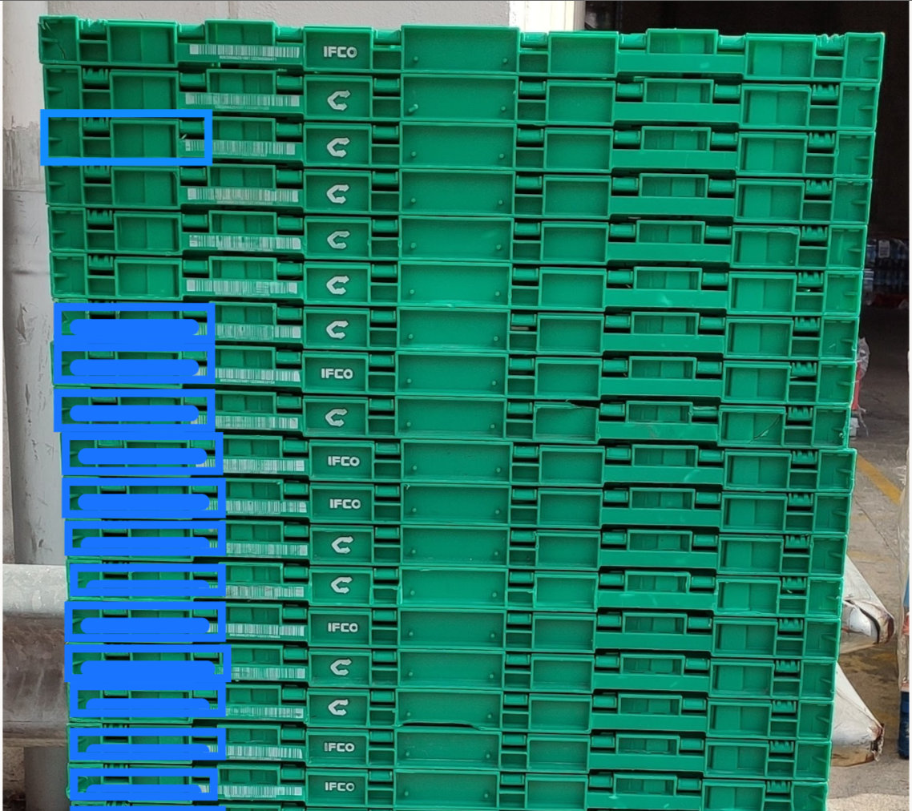
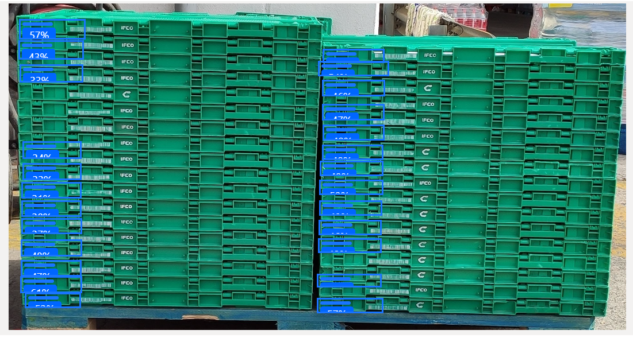
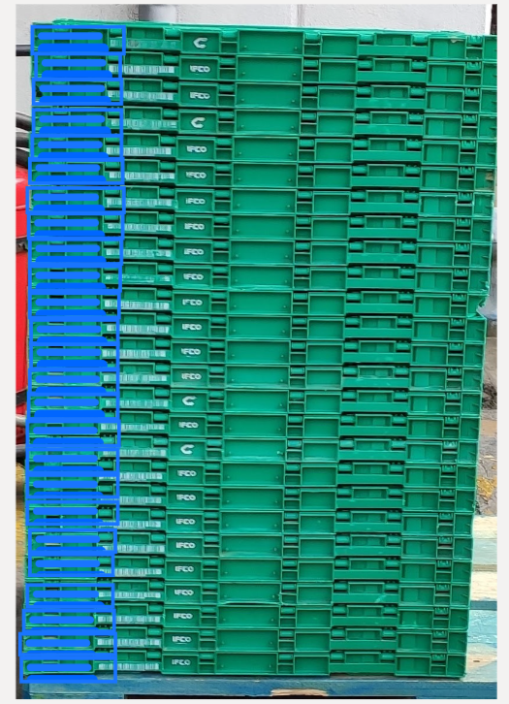
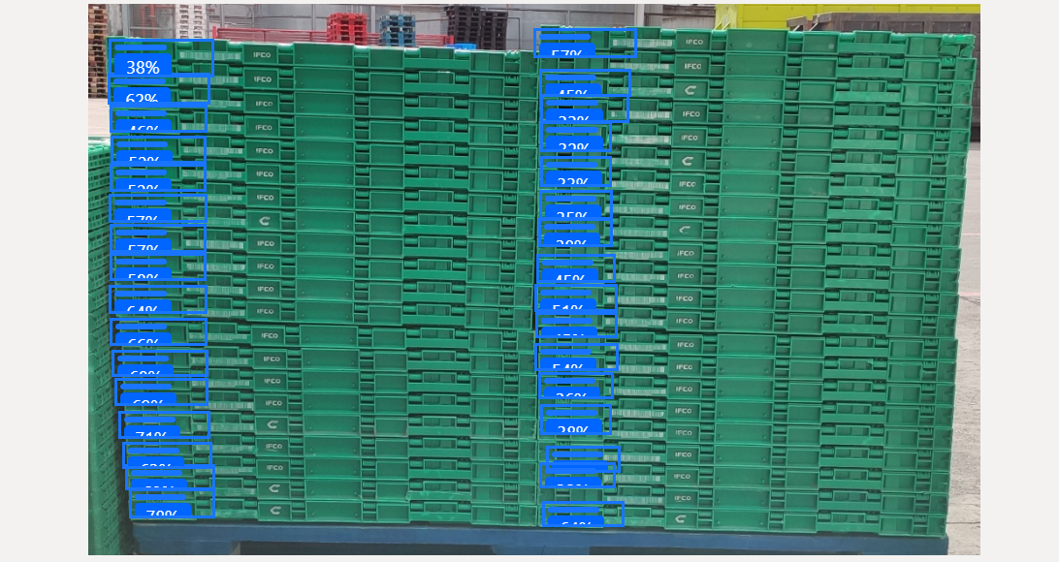
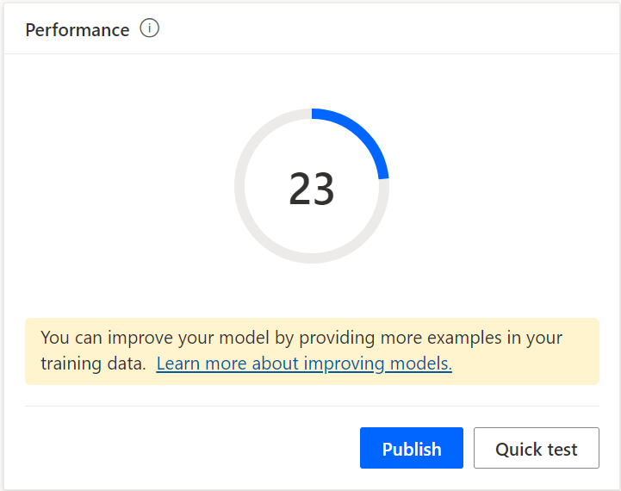
6. Box Detection Cropped Left Corner
Cropped images showing all stack.
The Perfomance Result was 23.
Some missing and overlapping detections.

Slide 14
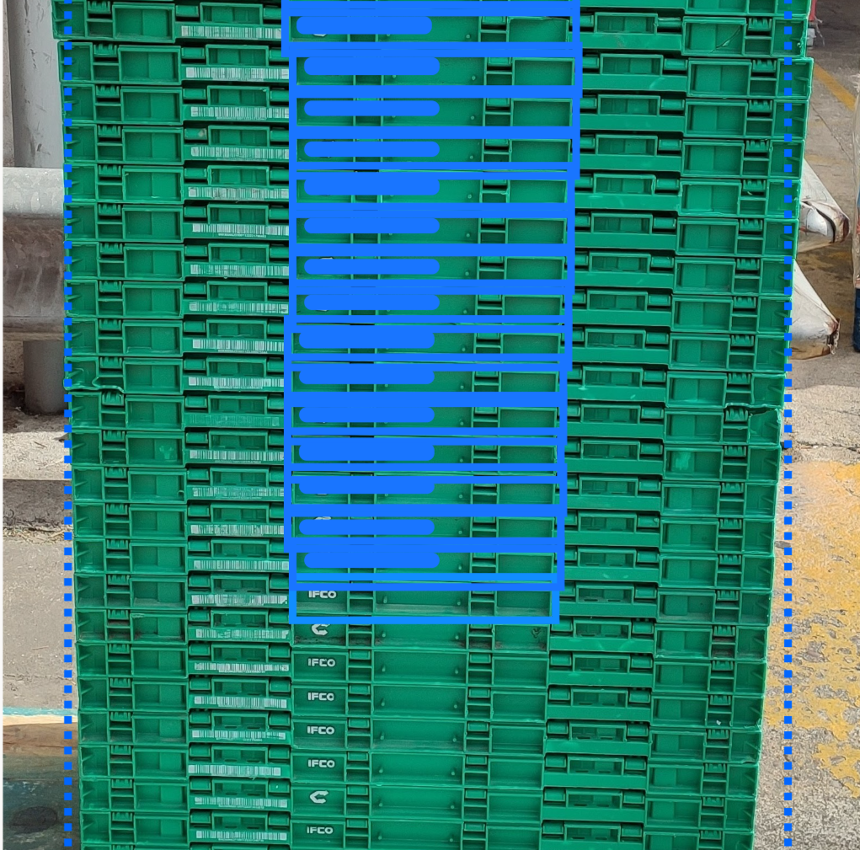
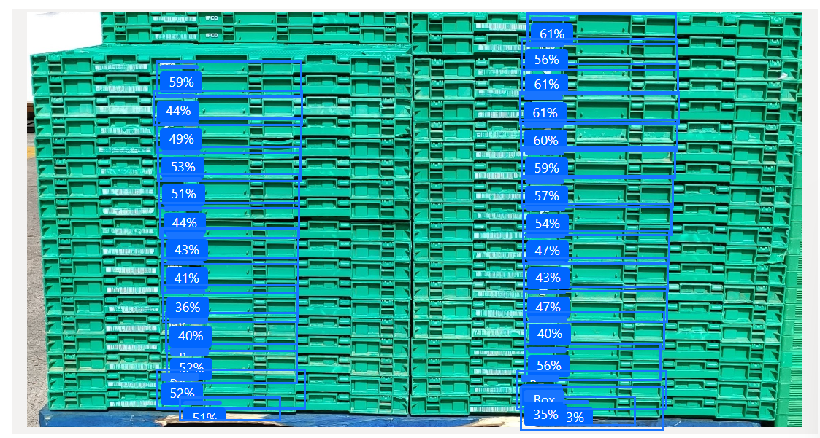
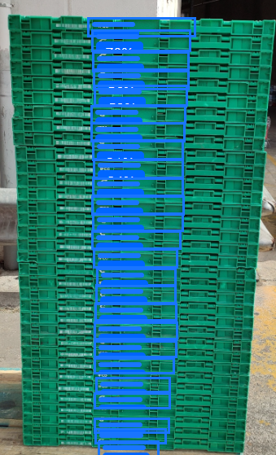
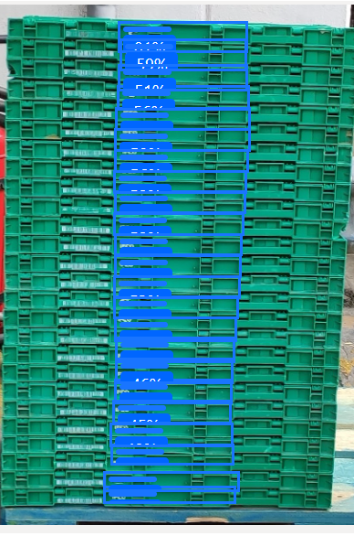
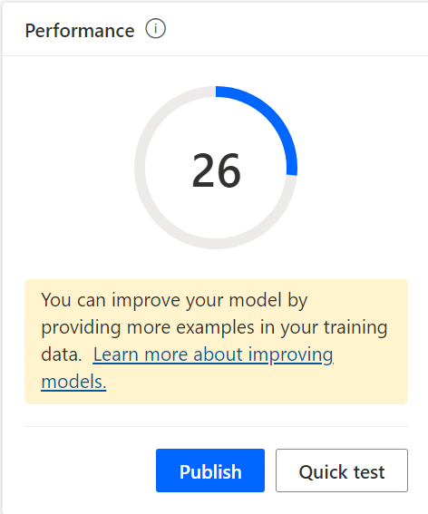
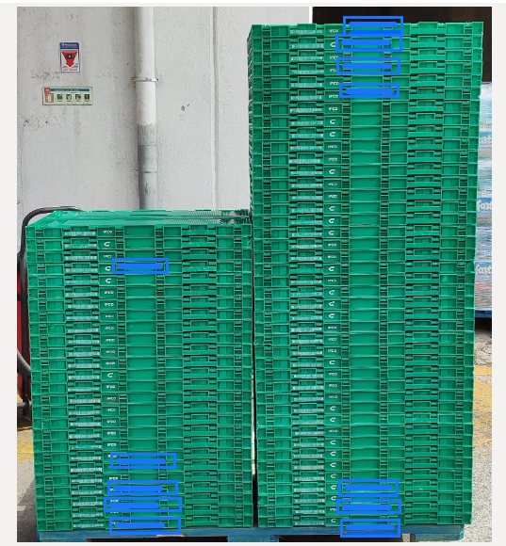
7. Box Detection Cropped Center
In this model was used a mix of cropped images enhancing the stack and others with some parts of the stack and was selected the center of box.
The Perfomance Result was lower than expected.
There was high hopes on this model since it took a lot of selections and each one being precise.
Still gave a lot of missing detections.

Slide 15
Model Evaluation
Models with better results:
5, 6, 7
Recommendations based on results:
Object Selection with best height/width ratio have better results (100/10 gives worst result than 100/50)
Amplified images (boxes stack need to be cropped)
High number of images and tag selections
Patterns with lot of details can confuse the model, so selecting a simple distinguishable part is the best choice
Box Detection with Image Parts Symbol Letter

Slide 16
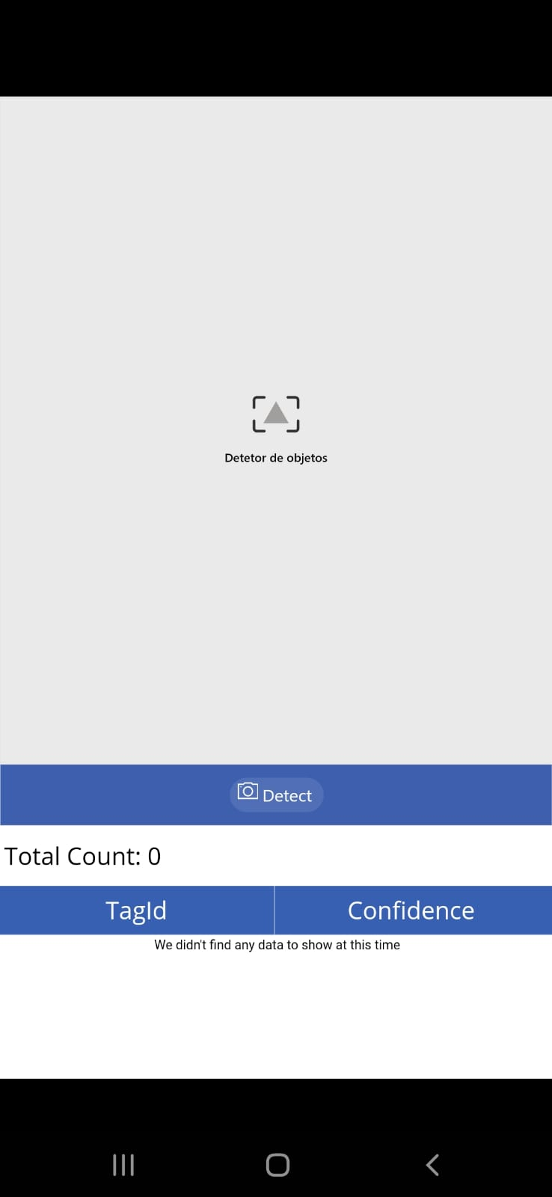
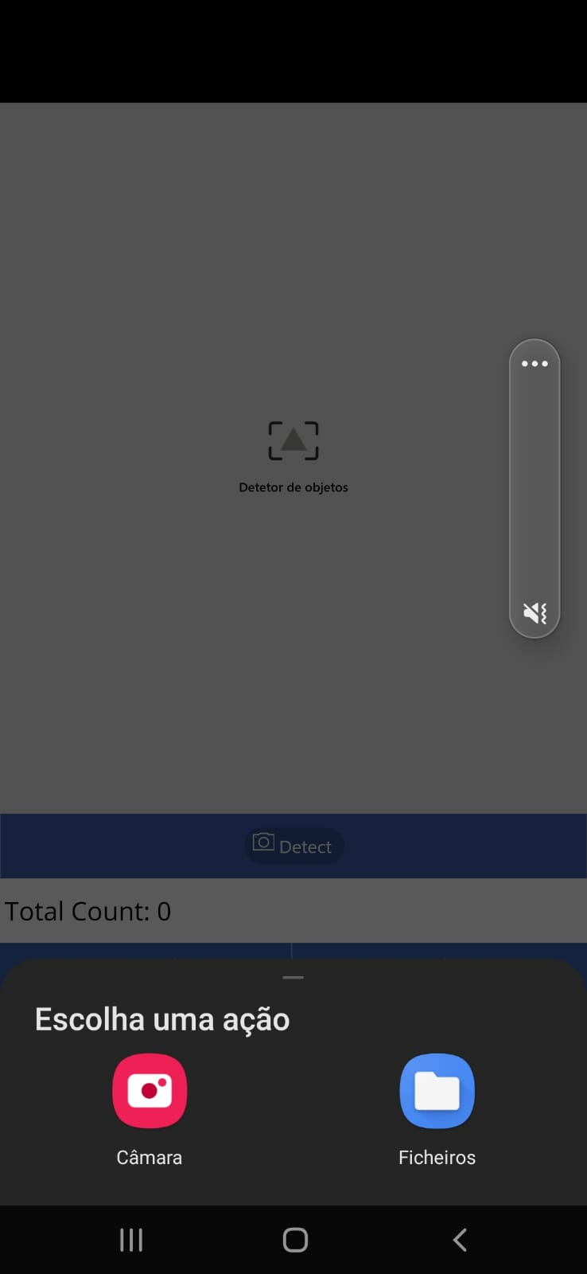
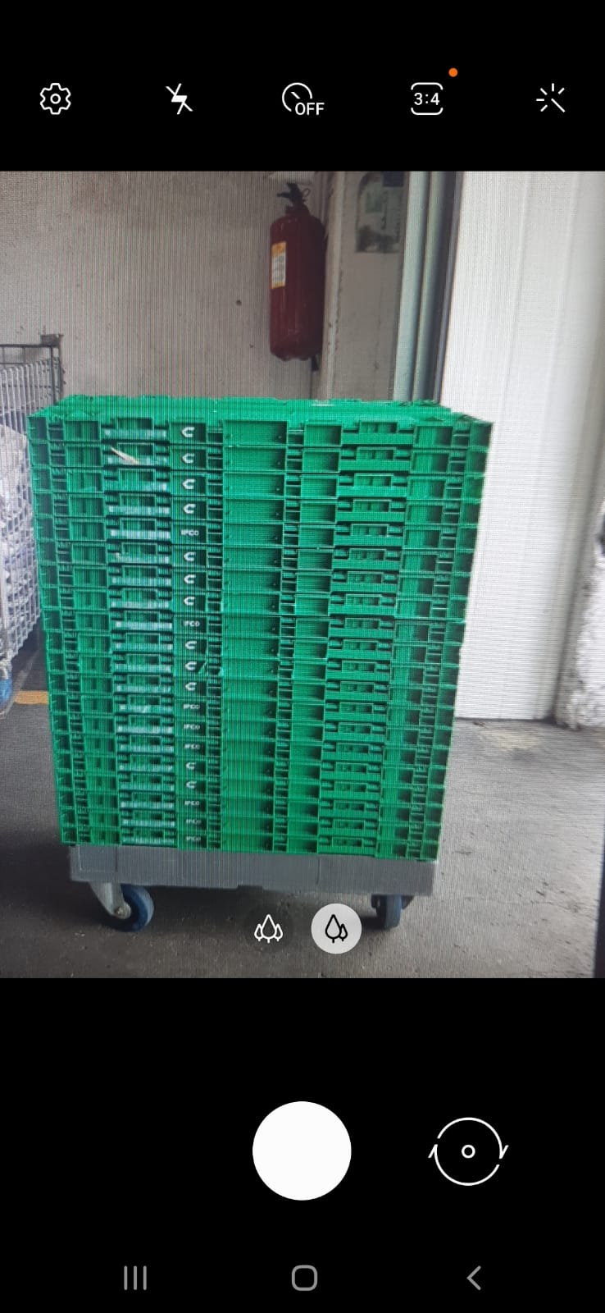
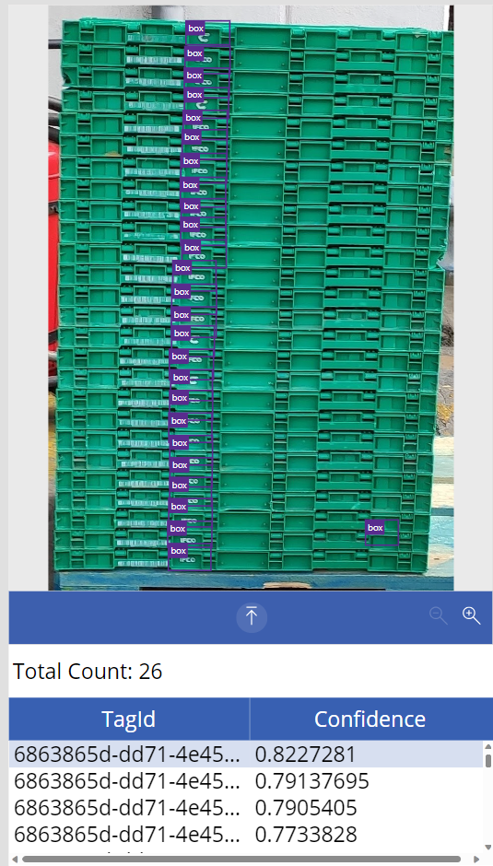


User Interface MS Power Apps

Slide 17

Model Evolution
Model 5. Box Detection with Image Parts Symbol Letter
Metrics:
Precision - True Positives / (True Positives + False Positives)
Recall - True Positives / (True Positives + False Negatives)
F1 Score - 2 * Precision * Recall / (Precision + Recall)
Choosed 5 images for testing.
Registed the real number of boxes in each image.
Registed the values of images, tags, and the respective metrics in each version iteration.

Slide 18

Model Evolution
After analysing the results, there is an increase of F1 score after each version, stagnating in version 4.
The number of wrong and missing detections decreased drasticly over the versions, increasing precision and recall.
F1score increased with more images and tags.
MS Performance start declining in Version 4.
In Version 4, it was given images with less resolution and tags with less size, that made the model have less MS Performance, and the average precision stagnated a bit from there. A reason for that may be the training path choosen in Version 4, that would cause the model to deviate. An option could be resume the training from Version 4 and make a diferent selection of images and tags.

Slide 19
Conclusions
Ai Builder
Pros:
Easy and simple to use.
Straightforward to solution.
User Friendly (used in Power Apps)
Fast Solution.
Potential good solution with a lot of training.
Good results with small amount of training given.
Cons:
Still small performance for what is needed.
Limited to MS PowerApps and flows.
Doesn’t have a model proper for mass detection and smaller objects.
Not optimal for this Use Case.

Slide 20
Pricing
Ai Builder
Minimum 500$/month

Slide 21


Thank You

